Slide 1
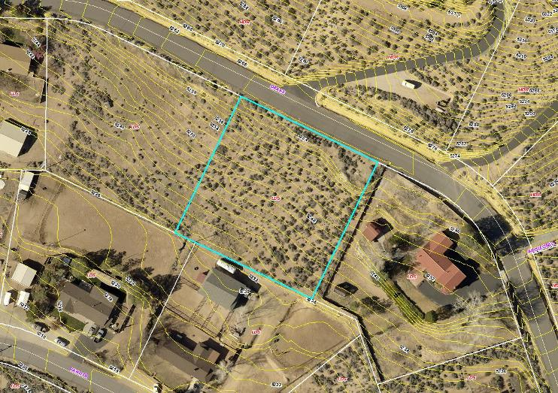
Variance Case No. WPVAR18-0001
Washoe County
Board of Adjustment
August 2, 2018
Taylor

Slide 2
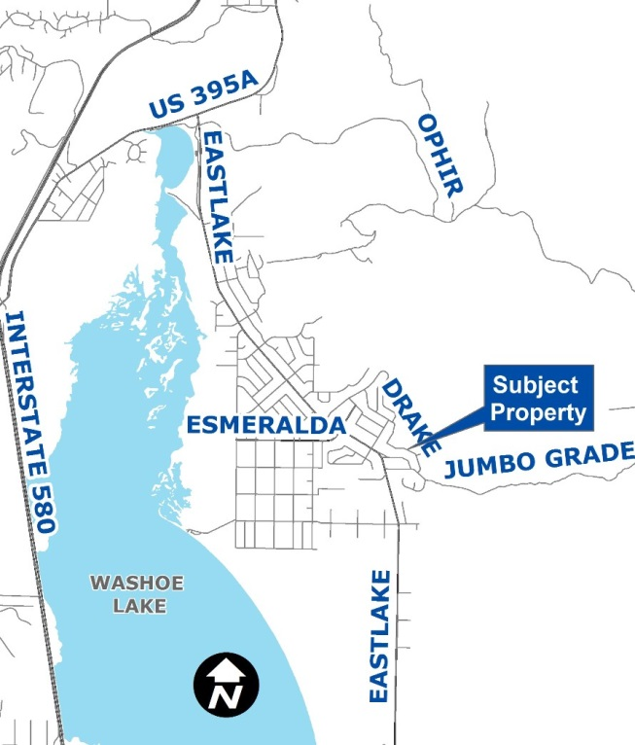
Vicinity Map
4340 Drake Way in east Washoe Valley
¼ mile north of Jumbo Grade
Low Density Suburban
.96-acres

Slide 3
Overview of Request
Reduce 15-ft front yard setback to 0-feet for a driveway bridge and walkway bridge up to 6-feet high
10-ft from edge of Drake Way pavement
3-ft high steel mesh safety railing
Home is NOT part of this request – it meets setbacks
Property has slopes >20%

Slide 4
Relevant Code Standards
Decks <18” don’t have setback standards
  Proposed decks are up to 6-ft in height
  At front setback, drive deck is 4’-9” above grade and walk deck is 4-ft above grade
Context: Tahoe area allows drive/walk decks in front yard setback on downslope lots. Rest of County does not have this exemption.

Slide 5
Property Constraints
Slopes over 20%
Home location minimizes disturbance as it is near the roadway
Well/septic locations/setbacks

Slide 6
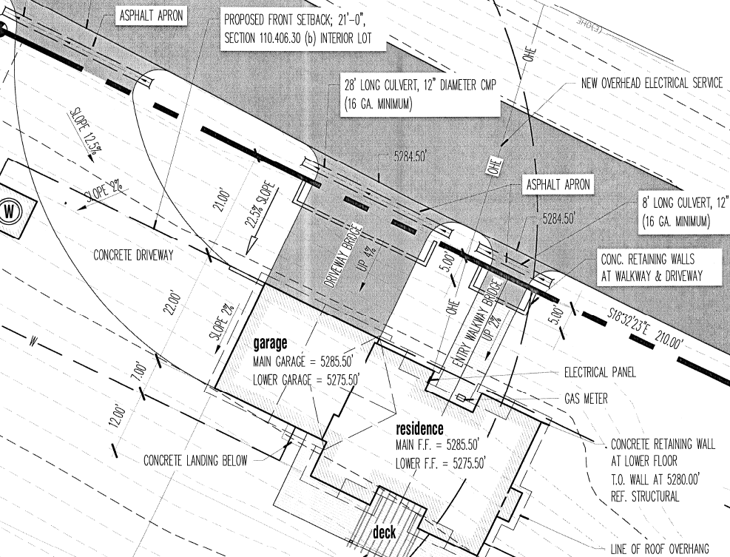
Site Plan (Excerpt)
DRAKE WAY

Slide 7
Aerial Photo w/2-ft Contours

Slide 8
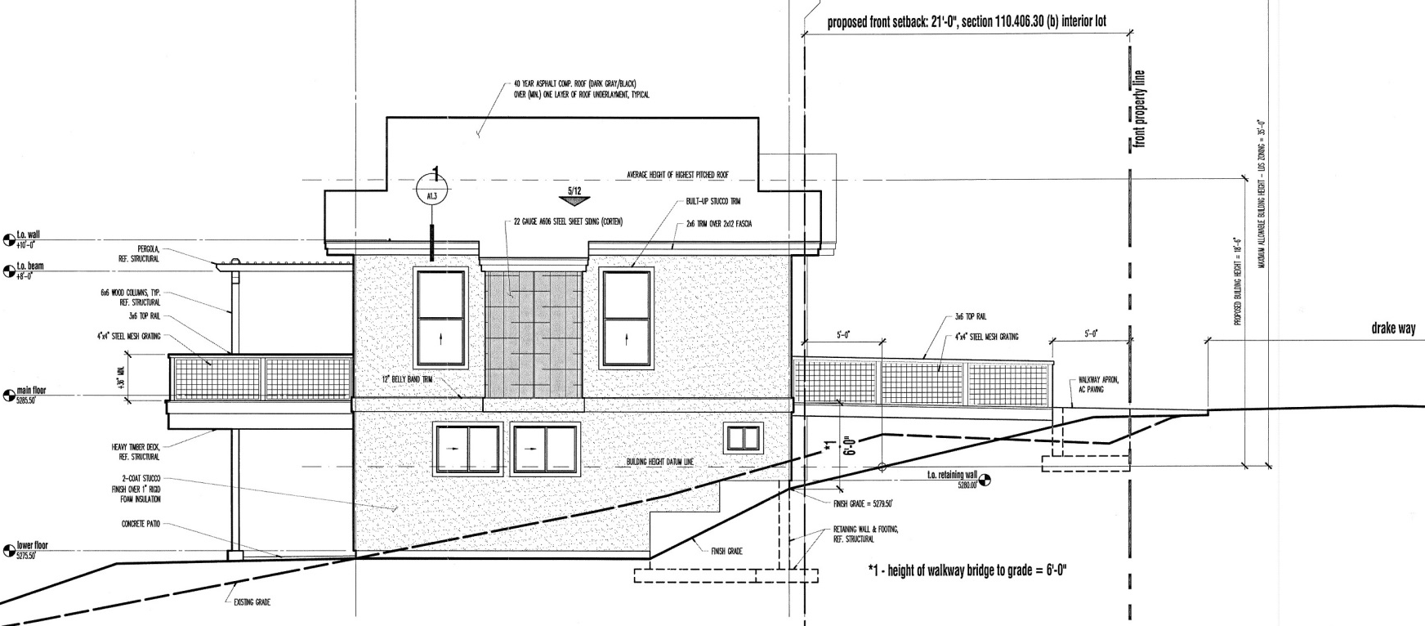
East Elevation
Property Line
Edge of Pavement
Setback Line (approx.)
Driveway bridge, max. 6-ft from grade to drive deck; 4’9” max. within front yard setback

Slide 9
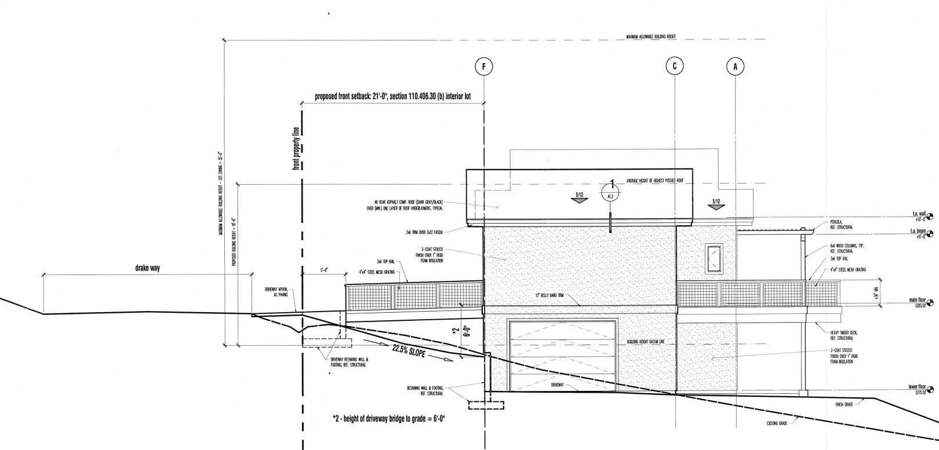
West Elevation
Property Line
Edge of Pavement
Setback Line (approx.)
Walkway bridge, max. 6-ft from grade to walkway deck; 4-ft max. within front yard setback

Slide 10
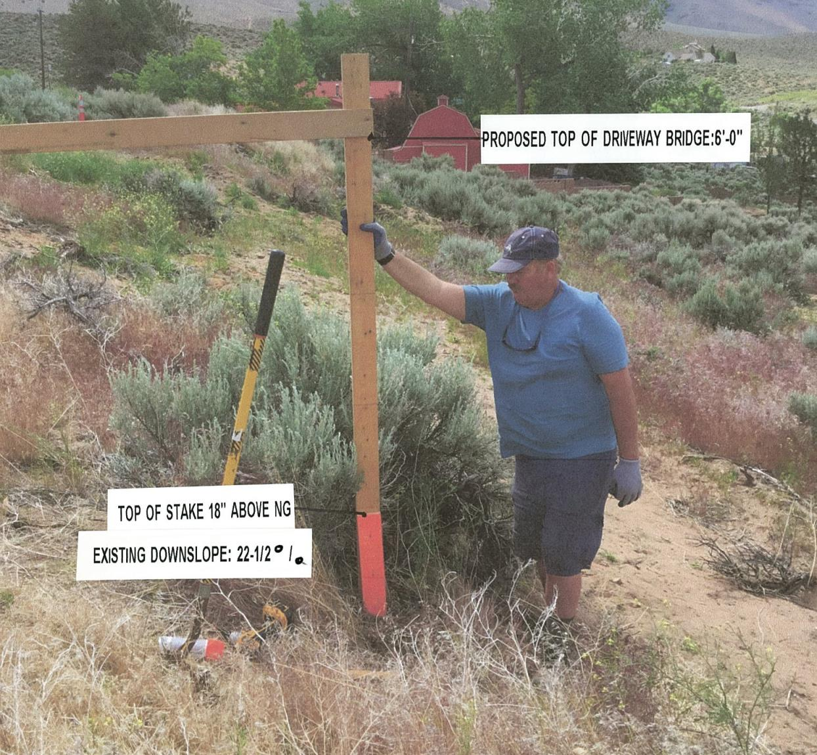
Site Photo

Slide 11
Project Impacts
Minimal impacts on surrounding area
Safer primary method for accessing home & garage
No safety impacts expected for pedestrians along Drake Way

Slide 12
Citizen Advisory Board (CAB)
July 5: South Truckee Meadows/Washoe Valley CAB
Voted unanimously to forward comments (no recommendation)
Questions on:
  Soils on the property
  Difference between bridge standards in Incline Village vs. Washoe Valley

Slide 13
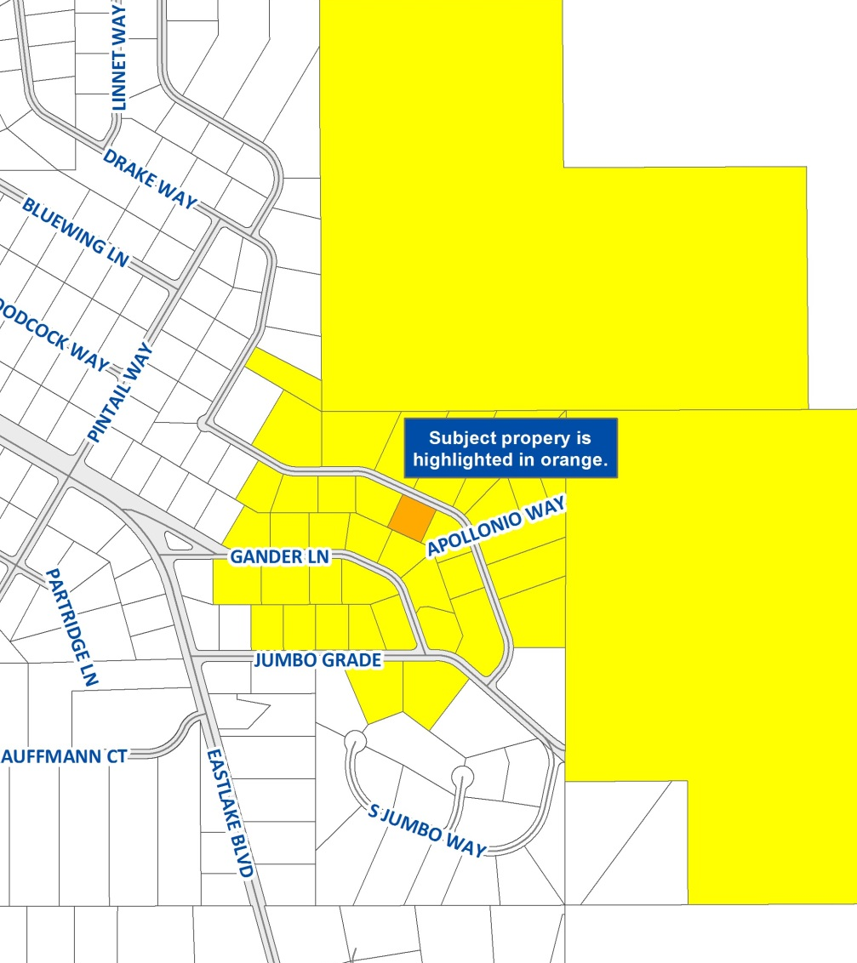
Public Notice
Notice provided to 37 owners of 40 parcels within 750-ft.
No comments received regarding this request

Slide 14
Reviewing Agencies
Washoe County Community Services Department
  Planning and Building
  Engineering and Capital Projects
Truckee Meadows Fire Protection District
Washoe County Health District
Regional Transportation Commission
Washoe-Storey Conservation District
AT&T and NV Energy

Slide 15
Required Findings
Special Circumstances
No Detriment
No Special Privileges
Use Authorized
Recommendation: Approval with conditions

Slide 16
Possible Motion
I move that, after giving reasoned consideration to the information contained in the staff report and information received during the public hearing, the Washoe County Board of Adjustment approve Variance Case WPVAR18-0001 for Gary and Melanie Taylor, with the Conditions of Approval included as Exhibit A for this matter, having made all four required findings in accordance with Washoe County Development Code Section 110.804.25.

